Slide 1
Person Detection
from a
Top-View Perspective
Baldascino Giovanni - 1097405
Squarcella Loisi - 1096539

Slide 2
OUTLINE
Introduction
State of Art
Materials and Methods
Results and Discussions
Conclusion and Future Works
Person Detection
Feature based Techniques
One-stage Detectors
Single-shot Detectors
Labeling
Training
Fine Tuning
Evaluate
1

Slide 3
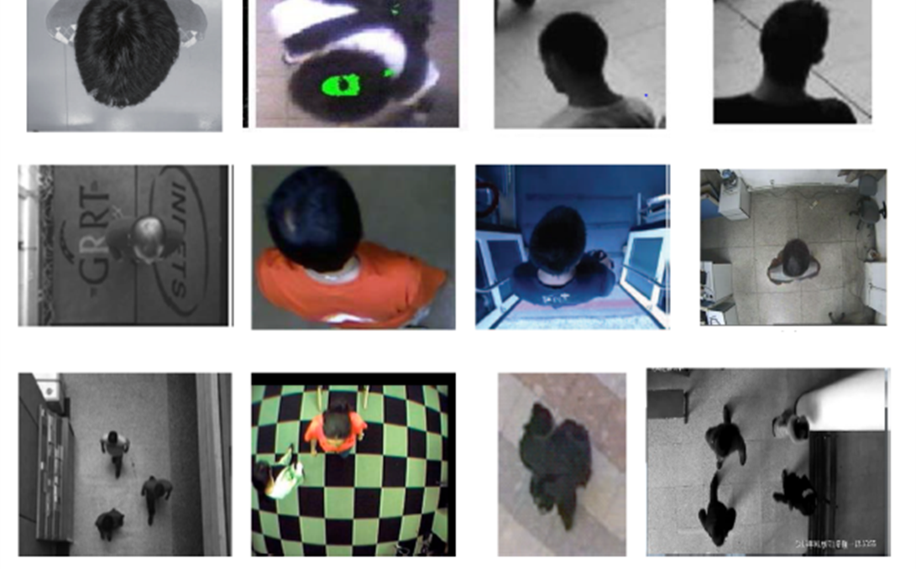
INTRODUCTION
Person Detection from a Top-View Perspective by using most recent object detection frameworks.
The aim is to build an efficient model to detect the people in the scene. The provided scenario is a retail environment.
MAIN STEPS:
Definition of the Region of Interest (ROI);
People localization.
2

Slide 4
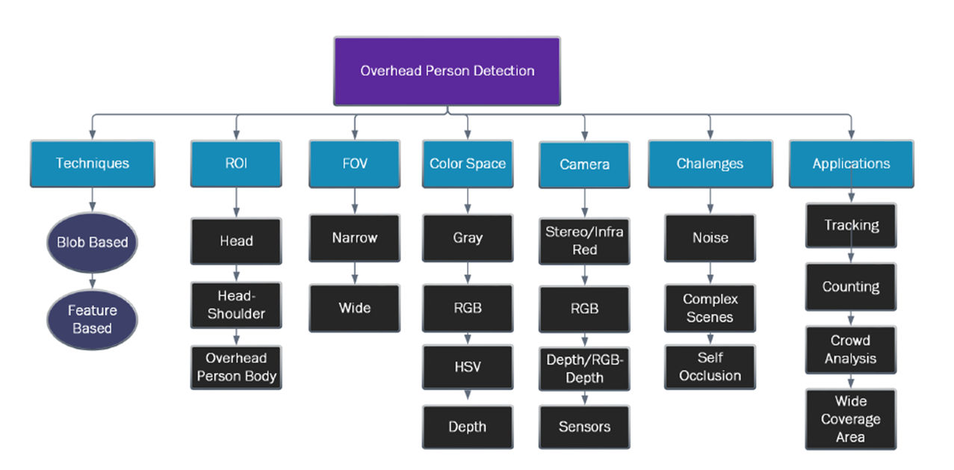
STATE OF ART – Person Detection
3

Slide 5
STATE OF ART – Person Detection
3

Slide 6
STATE OF ART – Person Detection
3

Slide 7
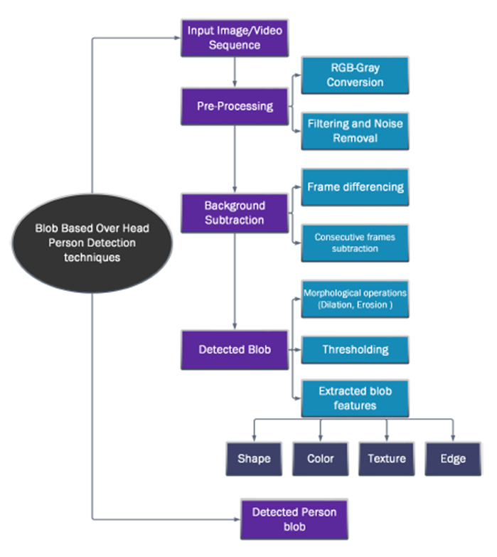
STATE OF ART – Person Detection
In Blob based Techniques a foreground image is obtained from background subtraction. Different pre-processing techniques are also used to remove noise, shadow and illumination.
A threshold is set to get the desired foreground image. From the foreground image the blob is extracted which is further classified into categories. The classification is based on the shape, color, motion or other feature of the blob.
4

Slide 8
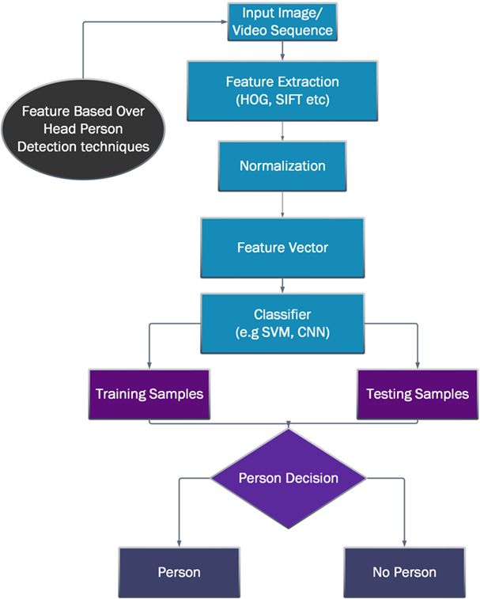
STATE OF ART – Person Detection
These Feature based Techniques operate on features extracted from overhead view videos and images. The extracted features are further used to classify person and non-person images.
The extracted features contain shape, color, texture, etc.… Including SIFT and HOG algorithms to detect person. The images are often divided into samples for training and testing.
5

Slide 9
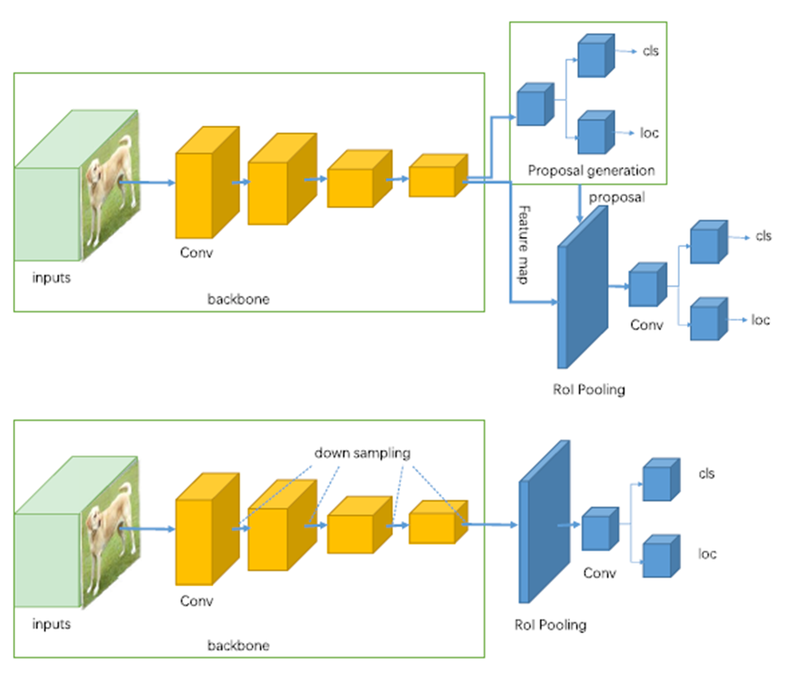
STATE OF ART – Feature based Techniques
Two-stage Detectors (R-CNN, Faster R-CNN, etc..) use a Region Proposal Network to generate regions of interests and send the region proposals down the pipeline for object classification and bounding-box regression.
One-stage Detectors (YOLO, SSD, etc..) treat object detection as a simple regression problem by taking an input image and learning the class probabilities and bounding box coordinates.
6

Slide 10
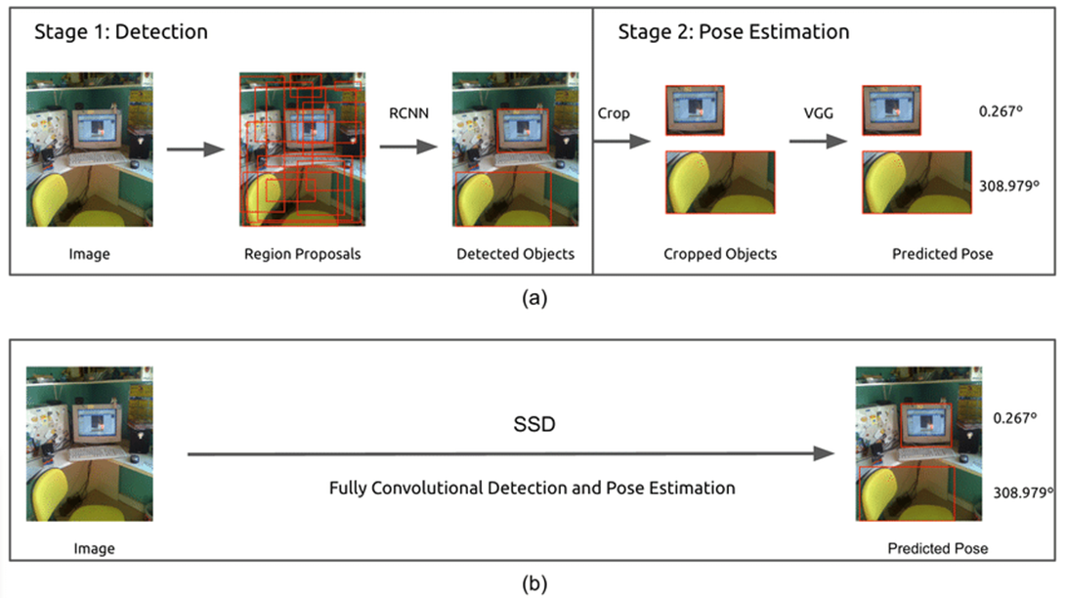
STATE OF ART – Feature based Techniques
(a) Two-stage Detector (b) One-stage Detector
7

Slide 11
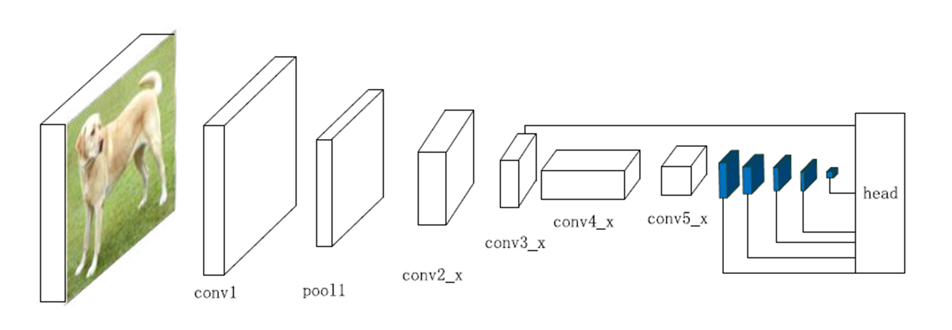
STATE OF ART – One-stage Detector
SSD (Single-shot Detector) discretizes the output space of bounding boxes into a set of default boxes over different aspect ratios and scales per feature map location.
In SSD the prediction layer is acting on fused features of different levels. Head module consists of a series of convolutional layers followed by several classification layers and localization layers.
8

Slide 12
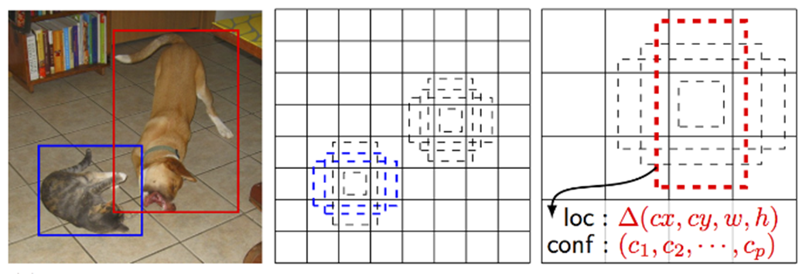
STATE OF ART – Single-shot Detector
During training time, SSD has matched two default boxes. One with the cat and one with the dog. They are treated as positives bounding boxes and the rest are treated as negatives. Each prediction is composed of:
Bounding box with shape offset (∆cx, ∆cy, w and h);
Confidences for all object categories or all the classes.
9

Slide 13
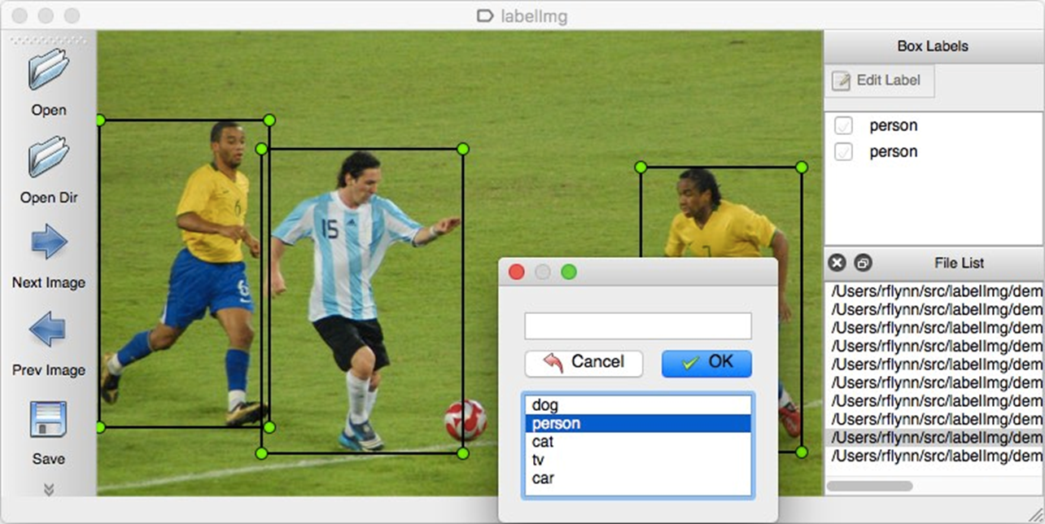
MATERIALS AND METHODS – Labelling
Dataset annotation using LabelImg. LabelImg is a graphical image annotation tool.
It is written in Python and uses Qt for its graphical interface.
Annotations are saved as XML files in PASCAL VOC format. It also supports YOLO format.
Training set → 70%
Testing set → 30%
Validation set → 30% of training set
10

Slide 14
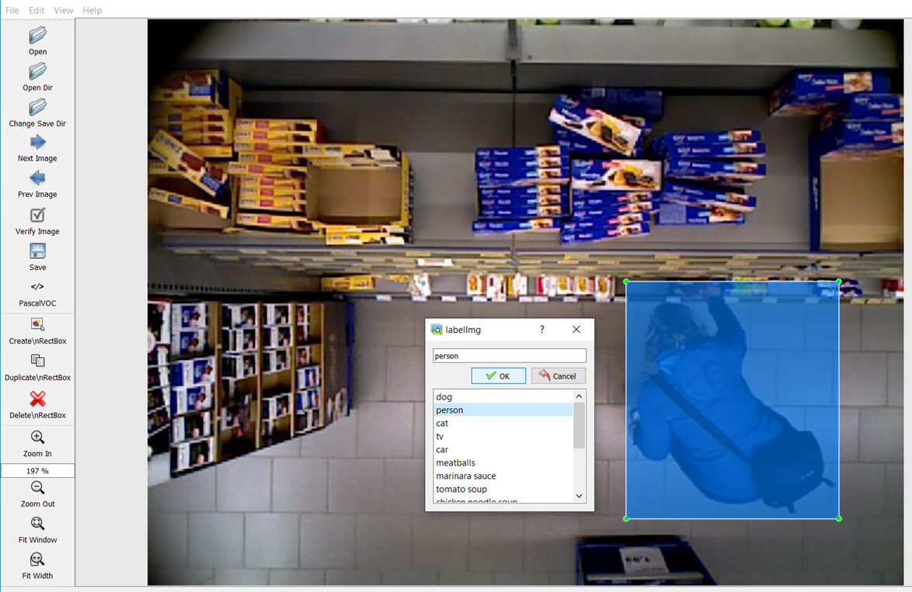
MATERIALS AND METHODS – Labelling
Build and launch the tool;
Click 'Change save dir' in Menu/File;
Click 'Open Dir’;
Click 'Create RectBox’;
Click and release left mouse to select a region to annotate the rectangle box and add a label;
Use right mouse to drag the rectangle box to copy or move it.
11

Slide 15
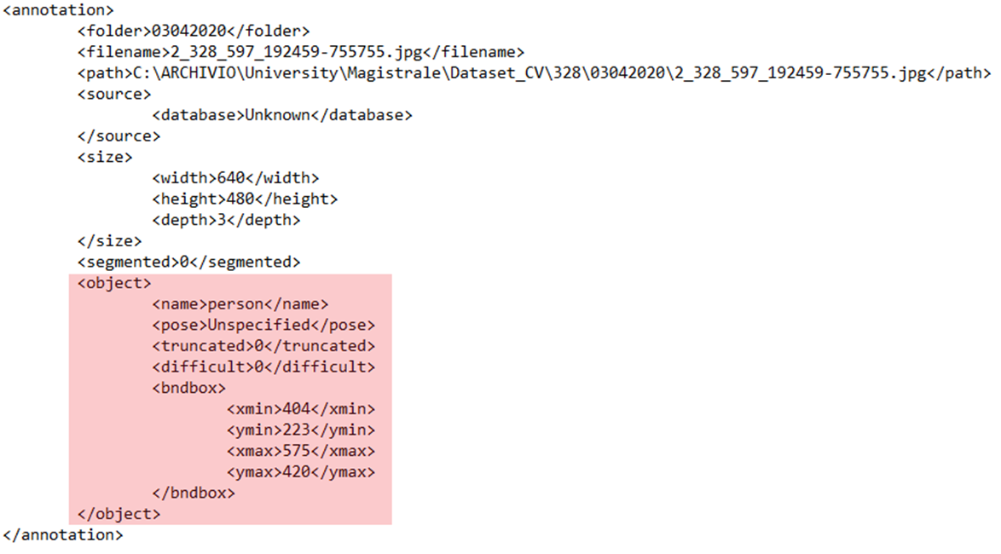
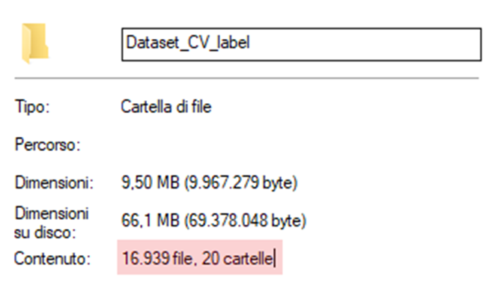
MATERIALS AND METHODS – Labelling
The <object> tag defines the label, in this case the only class, person, is identified by the <name> tag.
The bounding box is located inside the <bndbox> tag, through 4 coordinates <xmin> <ymin> <xmax> <ymax>.
12

Slide 16
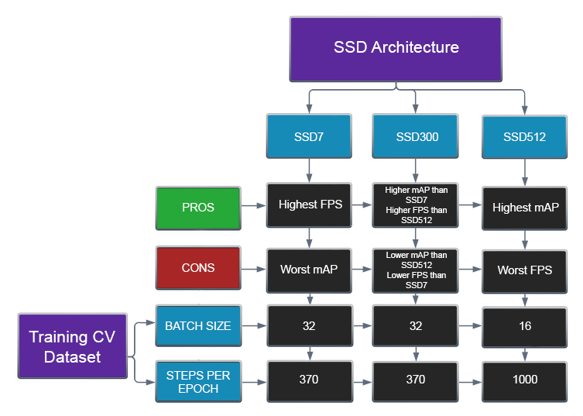
MATERIALS AND METHODS – Training
13

Slide 17
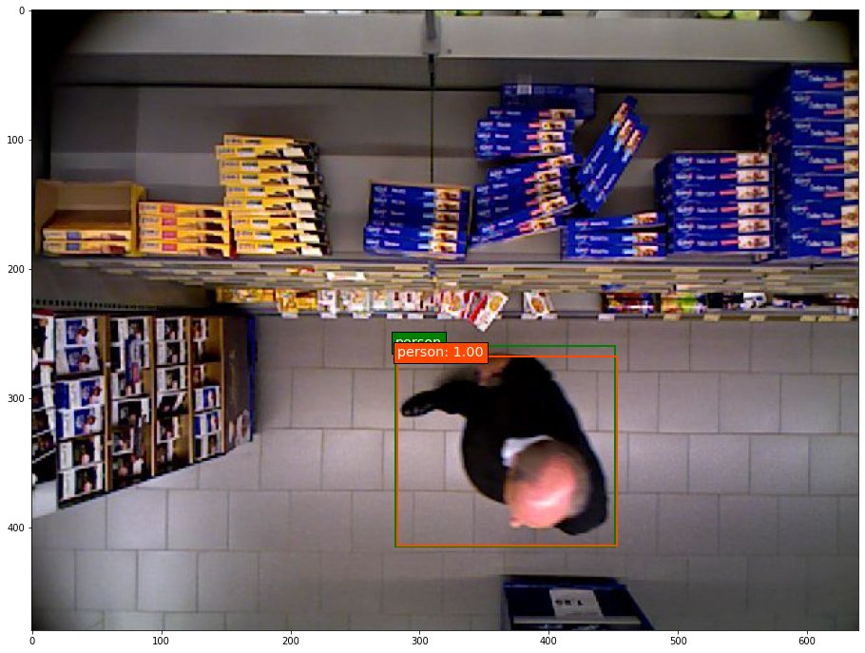
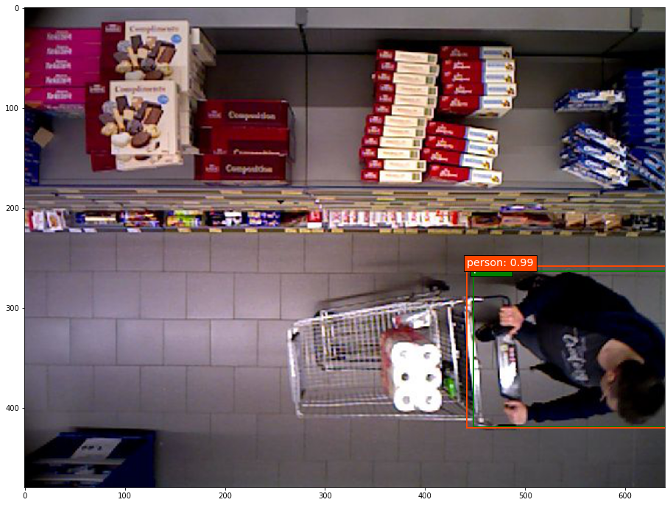
MATERIALS AND METHODS – Fine Tuning
The SSD300 and SSD512 presented weights related to models already trained on the Pascal VOC 07 + 12 dataset; a fine tuning of the weights was made to go from 20 classes to the only <person> class.
SSD512 trained from scratch
SSD512 after fine tuning
14

Slide 18
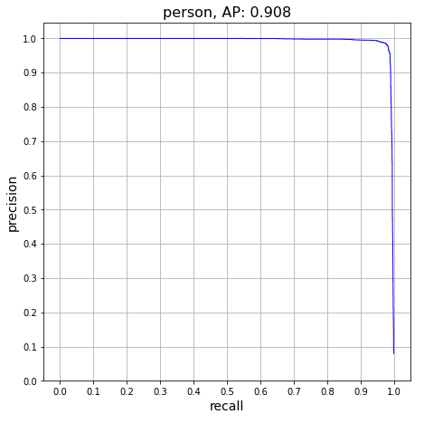
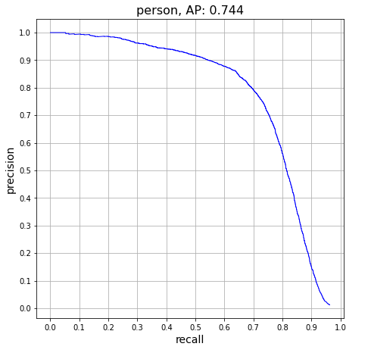
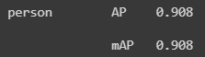
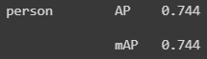
MATERIALS AND METHODS – Evaluate
The metric used for the evaluation is mAP (mean Average Precision) and recall.
SSD512 trained from scratch on CV
SSD512 subsampled weight CV
15

Slide 19
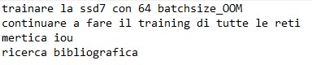
TODO

Slide 20
GRAZIE PER L’ATTENZIONE

